Slide 1
Adapter, Façade, and Template Method
CS350/SE310, Fall, 2015

Slide 2
Pattern Categories
Creational patterns involve object instantiation and all provide a way to decouple a client from objects it needs to instantiate
Any pattern that is a Behavioral Pattern is concerned with how classes and objects interact and distribute responsibility
Structural Patterns let your compose classes or objects into larger structures

Slide 3
US-made laptop in a European country?

Slide 4
Example
Your SW system uses a library
You change supplier:
New library has a different interface from the old one
(of course, you had programmed to that interface!)
You don’t want to change your existing code
What do you do?

Slide 5
Real-world Example
Old-style Java: Enumerators over Collections
What if you still want
to use legacy code?
New-style Java: Iterators over Collections

Slide 6
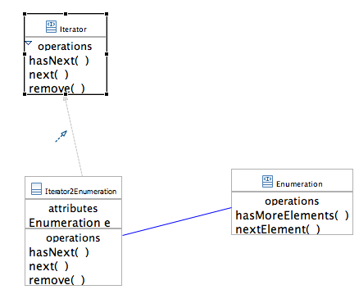
Writing the Adapter
public class Enumeration2Iterator
implements Iterator {
Enumeration e;
public boolean hasNext() {
return e.hasMoreElements();
}
public Object next() {
return e.nextElement():
}
public void remove() {
throw new UnsupportedOperationException();
}
}

Slide 7
OO Adapters
An adapter is a wrapper of objects that do not conform to given expectations of the client
It’s a disguise!
Implements an interface that is the same as the client expects
and holds on to the actual objects
hiding them
It encapsulates logic to translate from the expected interface to the new one

Slide 8
Adapter Pattern
The Adapter Pattern converts the interface of a class into another interface the clients expect. Adapter lets classes work together that couldn’t otherwise because of incompatible interfaces

Slide 9
The Adapter pattern
Classification:
Structural purpose; object scope
Context: Sometimes a library class can’t be properly re-used because of mismatch with the interface expected by its clients
Problem: You want to convert the incompatible interface of the library class into the expected one.
Solution: Wraps the library class with an object that hides it and expose the expected interface.
Consequences:
Same Adapter works for Adaptee and all of its subclasses
Adapter can add functionality to wrapped Adaptees
Decouples Client and Adaptee

Slide 10
A Home Theater Problem

Slide 11
Home Sweet Home Theater
A DVD player
A projection video system
An automated screen
Surround sound
And even
A popcorn popper

Slide 12
Home Theater

Slide 13
Watching a movie
Turn on the popcorn popper
Start the popper popping
Dim the lights
Put the screen down
Turn the projector on
Set the project input to DVD
Put the projector on wide-screen mode
Turn the sound amplifier on
Set the amplifier to DVD input
Set the amplifier to surround sound
Set the amplifier volume to medium
Turn the DVD player on
Start the DVD player playing

Slide 14
What if:
The movie is over?
Just want to listen to CD or Radio?
Upgrade your system?

Slide 15
watchMovie()

Slide 16
Facade Pattern
The Facade Pattern provides a unified interface to a set of interfaces in the subsystems. Façade defines a higher-level interface that makes the subsystem easier to use

Slide 17
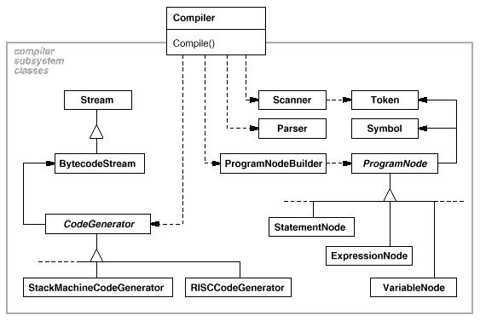
Facade Pattern

Slide 18
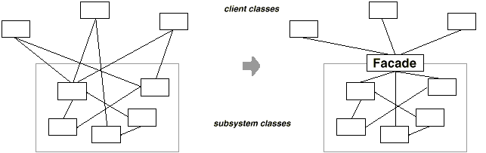
Facade Pattern

Slide 19
Hints
We should only invoke methods that belong to:
The object itself
Objects passed in as a parameter to the method
Any object the method creates or instantiates
Any components of the object

Slide 20
Which one is better
//Method 1:
Public float getTemp(){
return thermometer = station.getThermometer().getTemperature();
}
//Method 2:
Public float getTemp(){
return station.getTemperature();
}

Slide 21
Principle of Least Knowledge—talk only to your immediate friend.

Slide 22

Bullet Points
When you need to use an existing class and its interface is not the one you need, use an adapter
When you need to simplify and unify a large interface or complex set of interfaces, use a façade
An adapter changes an interface into one a client expects

Slide 23
Bullet Points
A façade decouples a client from a complex subsystem.
Implementing an adapter may require little work or a great deal of work depending on the size and complexity of the target interface
Implementing a façade requires that we compose the façade with its subsystem and use delegation to perform the work of the façade

Slide 24
A StarBuzz Problem

Slide 25
Prepare a Recipe
StarBuzz Coffee needs to print a recipe
Printout of the recipe, step by step
In the future, the company foresees an automated production of beverages according to the appropriate recipe
How would that change our system?

Slide 26
Planning for the future
Prepare() {
String recipeString = “…”;
System.out.println(recipeString);
}
Hmmm …
Perhaps it is better to already capture in the prepare() method the various recipe steps
As further method invocations
For now, each method simply prints out strings of their own.
In the future, it will actually carry out the step

Slide 27
prepare()
For coffee:
boilWater();
brewCoffeeGrinds();
pourInCup();
addIngredients();
For tea:
boilWater();
steepTeaInWater();
pourInCup();
addIngredients();
For cold drinks
…
Now:
boilWater() { System.out.println(“boil water”);
}
Later
…
Code duplication

Slide 28
Code duplication
It’s a code smell!
Strong hint that we need to refactor our design
Perhaps …
Abstract the common code out to a separate class?

Slide 29
Problem
Step 2 of both recipes cannot be abstracted out!
Specific to each type of beverage
brewCoffeeGrinds() vs. seepTeaInWater()
We cannot abstract out the whole preparation
Your solution?

Slide 30
The Template Method pattern

Slide 31
The Template Method Pattern defines the skeleton of an algorithm in a method, deferring some steps to subclasses. Template Method lets subclasses redefine certain steps of an algorithm without changing the algorithm’s structure

Slide 32
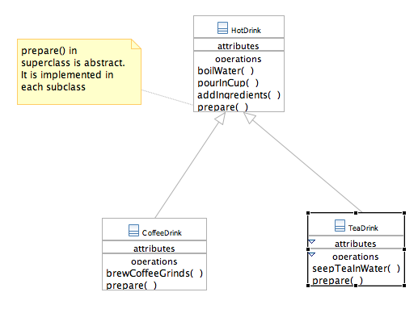
Abstract out common steps
Still, the code in the prepare() methods in both subclasses is very similar.
Except for step 2

Slide 33
Pushing the recipe algorithm up
public abstract class HotDrink {
final void prepare() {
boilWater();
//now step 2 !
brew();
pourInCup();
addIngredients();
}
abstract void brew(); // implementation left to subclasses!
void boilWater() { System.out.println(“Boil water now.”); }
void pourInCup() { System.out.println(“Pour drink now.”); }
}

Slide 34
brew()
brew() abstracts out step 2 of the recipe
Being an abstract method provides the necessary freedom of customization
In class CoffeeDrink:
brew() { this.seepTeaInWater(); }
In class TeaDrink:
brew() { this.brewCoffeeGrinds(); }

Slide 35
prepare() - a template method
The prepare() method is a template of the algorithm
Accounts for all algorithm steps
Some steps are implemented within same class
Some other steps are declared abstract …
… and delegated to non-abstract subclass implementations
public abstract class HotDrink {
final void prepare() {
boilWater();
//now step 2 !
brew();
pourInCup();
addIngredients();
}
A template method defines the steps of an algorithms
and allows subclasses to provide implementation of
some steps

Slide 36
Comparison
Before:
Coffee / Tea implement the algorithm separately
Change to the algorithm ➔ changes to both classes
Code duplication
New hot drink ➔ more code duplication
With a template method:
The HotDrink superclass encapsulates the algorithm
HotDrink maximizes reuse
Changes to the algorithm are more local
Other hot drinks types are easily added

Slide 37
Template Method - rationale
The Template Method Pattern defines the skeleton of an algorithm in a method
It then defers some steps to subclasses.
Template Method lets subclasses redefine certain steps of an algorithm
Without changing the algorithm’s structure

Slide 38
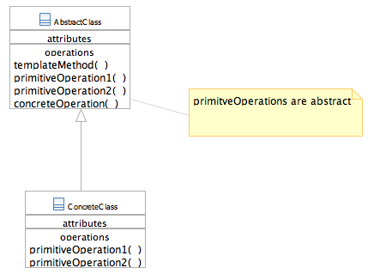
Template Method pattern - structure
abstract class AbstractClass {
final void templateMethod() {
primitiveOperation1();
primitiveOperation2();
concreteOperation();
}
abstract void primitiveOperation1();
abstract void primitiveOperation2();
void concreteOperation() {
// implementation here
…
}
}

Slide 39
Hooks in the Template Method
A “hook” is a method that is defined in AbstractClass …
… but with an empty or default implementation
Provides subclasses with an option to “hook into” the algorithm with their own customized “sub-routines”
Or ignore the hook altogether
abstract class AbstractClass {
final void templateMethod() {
primitiveOperation1();
primitiveOperation2();
concreteOperation();
hook();
}
abstract void primitiveOperation1();
abstract void primitiveOperation2();
void concreteOperation() {
// implementation here
…
}
void hook() { //empty }
}

Slide 40
Hook example
In the Coffe Joint project
The addIngredients() method can be used as a hook
In HotDrink we could have an empty implementation
Overridden in different ways in:
CoffeeDrink
TeaDrink
public abstract class HotDrink {
final void prepare() {
boilWater(); //concrete
brew(); //abstract
pourInCup(); //concrete
addIngredients(); //hook
}

Slide 41
Kinds of Methods in a Template Class
Concrete Methods (must not be overridden)
carry out some basic function that all the subclasses will want to use.
Abstract Methods (must be overridden)
Methods that are not filled in at all and must be implemented in derived classes.
Hook Methods (intend to be overridden)
Methods that contain a default implementation of some operations, but which may be overridden in derived classes.
Template Methods (not to be overridden)
Methods call any combination of abstract, hook and concrete methods. These methods describe an algorithm without actually implementing its details.

Slide 42
The Template Method Pattern Example
Suppose you had a PlainTextDocument class as follows:
public class PlainTextDocument {
...
public void printPage (Page page) {
printPlainTextHeader(); // Unique to PlainTextDocument
System.out.println(page.body());
printPlainTextFooter(); // Unique to PlainTextDocument
}
...
}

Slide 43
The Template Method Pattern Example
And then you wrote an HtmlTextDocument class like this:
public class HtmlTextDocument{
...
public void printPage (Page page) {
printHtmlTextHeader(); // Unique to HtmlTextDocument
System.out.println(page.body());
printHtmlTextFooter(); // Unique to HtmlTextDocument}
...
}

Slide 44
The Template Method Pattern Example
And then you wrote an HtmlTextDocument class like this:
public class HtmlTextDocument{
...
public void printPage (Page page) {
printHtmlTextHeader(); // Unique to HtmlTextDocument
System.out.println(page.body());
printHtmlTextFooter(); // Unique to HtmlTextDocument}
...
}

Slide 45
The Template Method Pattern Example
The printPage() methods in the PlainTextDocument and HtmlTextDocument classes look much alike
Whenever we see two such similar methods in subclasses, it makes sense to bring the methods together into a superclass method
We can write a printPage() template method in a superclass that allows for PlainTextDocument and HtmlTextDocument to provide their unique implementations of abstract methods to print the header and footer

Slide 46
The Template Method Pattern Example
Here is the TextDocument superclass:
public abstract class TextDocument {
...
public final void printPage (Page page) {
printTextHeader();
printTextBody(page);
printTextFooter();
}
public abstract void printTextHeader();
public final void printTextBody(Page page) {
System.out.println(page.body());
}
public abstract void printTextFooter();
...
}

Slide 47
The Template Method pattern
Classification:
Behavioral purpose; Class scope
Context: defines the skeleton of an algorithm in a method, and then lets subclasses redefine certain steps without changing the algorithm’s structure
Problem: you have to implement a procedure or algorithm that is general, but with fine-grained variants
Solution: Allows for the definition of customized steps (variants) while maintaining a consistent basic procedure
Consequences:
Promotes code re-use
Ensures required steps are implemented at some level
Binds all overridden steps together for each ConcreteClass: must make sure those variations always go together

Slide 48
Comments on Template Method
Straightforward use of polymorphism
Maximizes code reuse
Simple solution
Pitfall-free
Easy to identify its scope
Easy to use

Slide 49
Bullet Points
A “Template method” defines the steps of an algorithm, deferring to subclasses for the implementation of those steps
The Template Method Pattern gives us an important technique for code reuse
The Template Method’s abstract class may define concrete methods, abstract methods and hooks.

Slide 50
Bullet Points
Abstract methods are implemented by subclasses
Hooks are methods that do nothing or default behavior in the abstract class, but may be overridden in the subclass
To prevent subclass from changing the algorithm in the template method, declare the template method as final

